Slide 1

Thesis Title: Integrative Trajectory Forecasting for Autonomous Vehicles in Mixed Traffic Environments
Department of Computer Science & Engineering
Supervised By:
Md Rakibul Haque
Lecturer,
Dept. of Computer Science & Engineering, RUET.
Presented By:
Md. Nazmul Hossain ID : 1803170

Slide 2
Topic Outline
Introduction
Literature Review
Challenges
Objectives
Methodology
Dataset Details
Results & Performance Analysis
Conclusion
Limitations & Future Work
References

Slide 3
Introduction
Trajectory refers to a path that a vehicle moves through space over time.
For of an autonomous vehicle, trajectory not only the route but also it’s motion—speed, acceleration, and direction etc.
Fig – 1: Some Trajectories of Various Vehicle [7].

Slide 4

Introduction (CONT’D)
Mixed traffic environment consists of different types of road users, such as pedestrians, bicycles, motorcycles, cars, and buses, share the same space and interact with each other.
Fig – 2: Mixed Traffic Environment [1].

Slide 5
Literature Review
TrafficPredict: Trajectory Prediction for Heterogeneous Traffic-Agents [2]
Performances:
Using previous state-of-the-art approaches in accuracy for trajectory prediction in heterogeneous traffic.
Offer real-time performance without assumptions about traffic conditions or the number of agents.
Limitations:
The accuracy varies with traffic conditions and the historical data available.
Future improvements will consider additional constraints such as lane directions, traffic signals, and rules.

Slide 6
Literature Review (CONT’D)
Interactive Trajectory Prediction for Autonomous Driving via
Recurrent Meta Program Induction Network [3]
Performances :
Here, behavior estimation based on historical observation of all related cars including the target car and surrounding cars.
Also achieving lower mean error rates in trajectory prediction for both longitudinal and lateral directions.
Limitations:
Future developments are needed for a more advanced generator and observer structure to further reduce prediction errors and to extend the framework to more general scenarios, such as turns at intersections and highway merging.

Slide 7
Literature Review (CONT’D)
TraPHic: Trajectory Prediction in Dense and Heterogeneous Traffic Using Weighted Interactions [4]
Performances :
It is LSTM-CNN based hybrid network, where consider the fast moving vehicle by increase their weights.
Limitations:
It is designed for dense heterogeneous traffic scenarios, it is not effective for sparse traffic.
Here, do not use any batch normalization and dropout.

Slide 8
Challenges
Work on Urban Areas Consists of Mixed Traffics
Considering Driver Dynamic Behavior and Turning Radius
Reduce Prediction Error

Slide 9
Objectives
Deals with mixed traffic environment consists of various cars, bicycles, bikes, buses, pedestrians etc. in an urban areas.
Considering driver dynamic behavior and turning radius.
Also increasing the accuracy of the model is an obligatory part of my work.

Slide 10
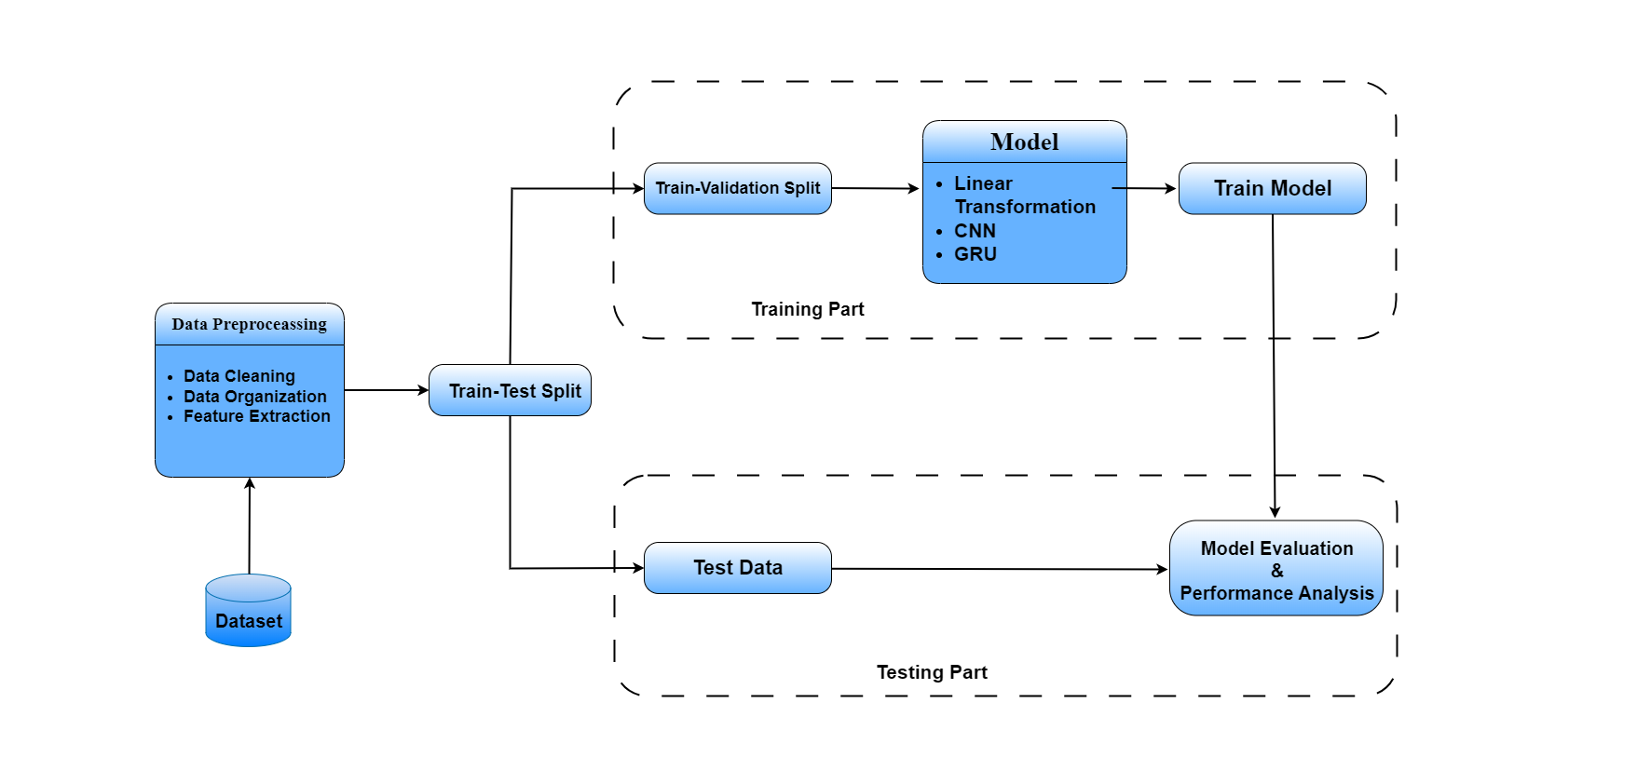
Methodology
Fig – 3: Methodology.

Slide 11
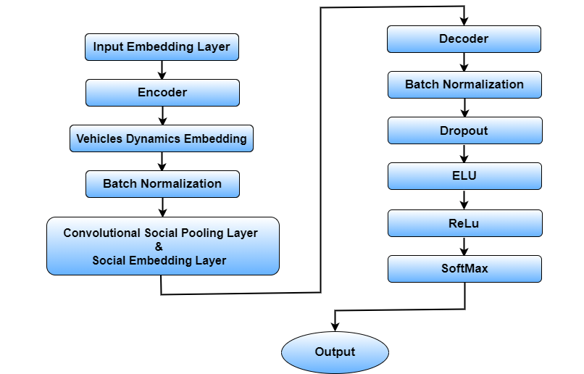
Methodology (CONT’D)
Fig – 4: Model Flow Chart.

Slide 12
Methodology (CONT’D)
Model Architecture
Horizon Map
Neighbor Map
Ego Agent
GRU
Conv1
Conv2
Conv2
+
GRU
Output
GRU
Conv1
GRU
Conv1
Conv2
Fig – 5: GRU-CNN Architecture

Slide 13
Dataset Details
Dataset Name: NGSIM (Next Generation Simulation) Dataset
Source: The NGSIM dataset originates from the Next Generation Simulation (NGSIM) program, a project by the U.S. Department of Transportation (DOT) [5]
Data Collection: The NGSIM dataset was obtained through the utilization of tower-mounted cameras, providing a bird’s-eye perspective for data collection.
No. of Frames: 10.2 × 10³
Average Instances per frame
Agent | Avg. Instance
Car | 981.4
Bike | 3.9
Track | 28.2
Density: 1.85 × 10³
per km
Visibility: 0.548 km

Slide 14
Dataset Details (CONT’D)
Attributes Details: NGSIM dataset has 25 Attributes. Some of them described below –
Attributes | Details
Positional Data | It represents the spatial position of an object in a frame.
Motion Data | It represents the speed, acceleration etc. of a vehicle.
Vehicle Information | It represents the vehicle id, type, shape, heading etc.
Time Data | It represents the timestamps of a frame capture.

Slide 15
Results & Performance Analysis
We implemented the model with the NGSIM Dataset –
Average Displacement Error (ADE) | 2.86164
Final Displacement Error (FDE) | 5.19008
Operation | Value (s)
Data Loading Time | 0.418
Training Time | 30961.05
Testing Time | 119.77

Slide 16
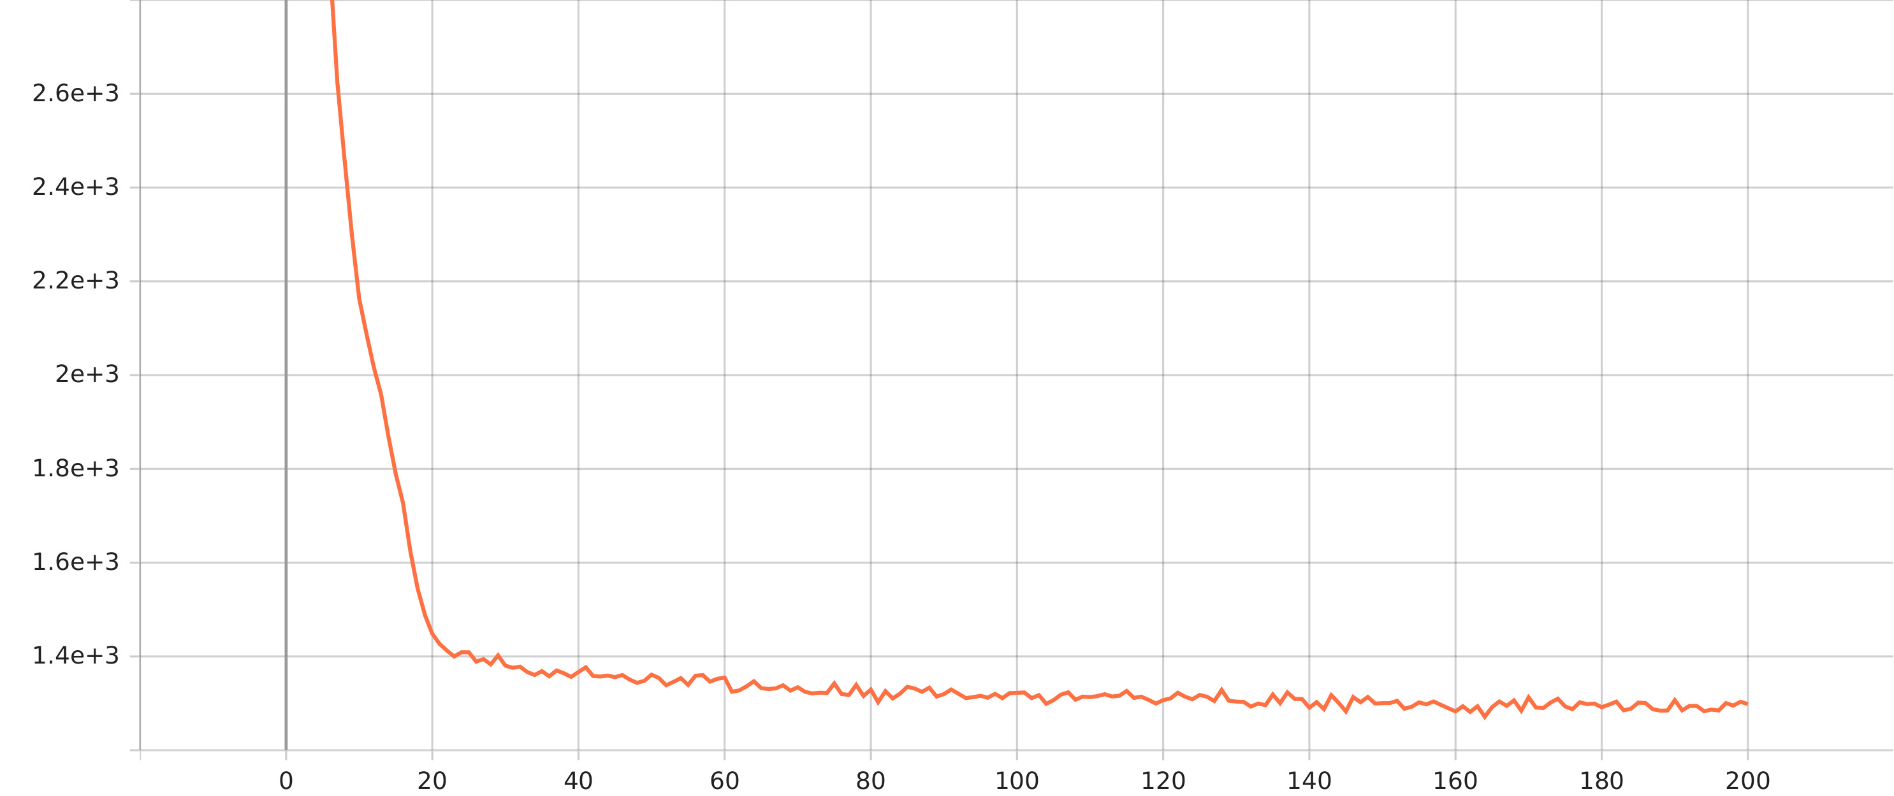
Results & Performance Analysis
Average Training Loss vs Epoch Curve –
Figure - : Average Training Loss vs Epoch Curve.

Slide 17
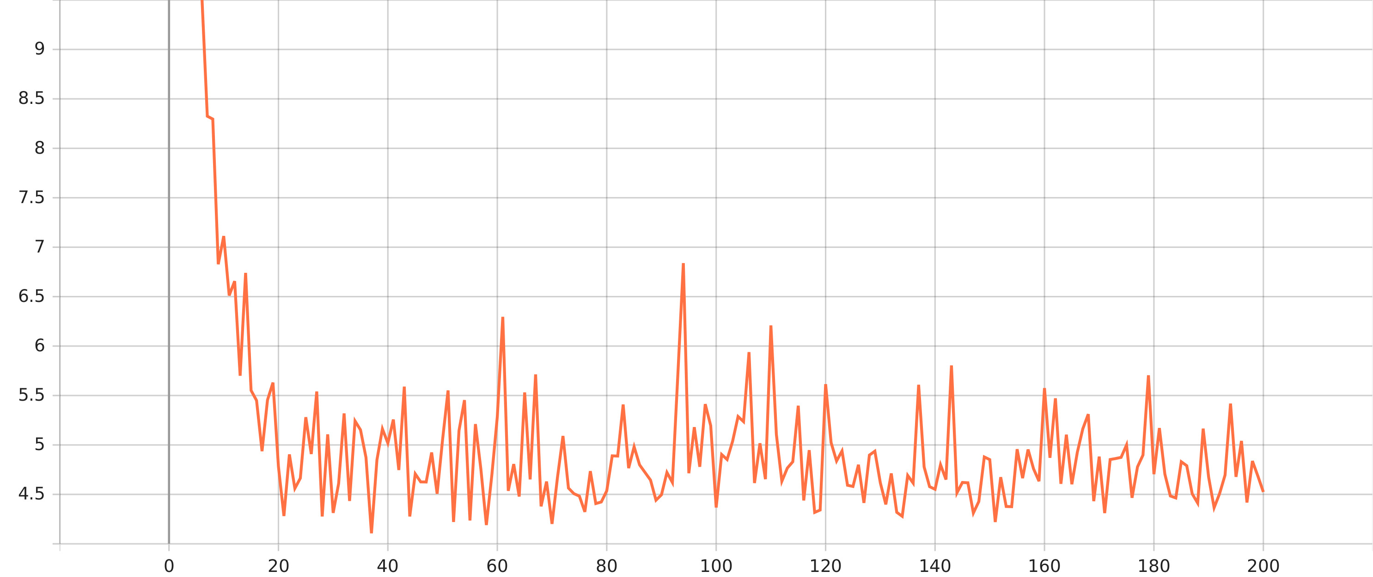
Results & Performance Analysis
Average Validating Loss vs Epoch Curve –
Figure - : Average Validating Loss vs Epoch Curve.

Slide 18
Results & Performance Analysis
Comparison of previous works with our model using NGSIM dataset –
Model | ADE | FDE
RNN-ED [7] | 6.86 | 10.02
S-LSTM [8] | 5.73 | 9.58
S-GAN [9] | 5.16 | 9.42
CS-LSTM [10] | 7.25 | 10.05
TraPHic [4] | 5.63 | 9.91
Our Model | 2.86 | 5.19

Slide 19
Conclusion
In conclusion, our study presents a novel trajectory forecasting model tailored to the NGSIM dataset. Leveraging a custom-designed GRU-CNN architecture, we achieved promising results on trajectory forecasting, which is helpful for autonomous vehicle or advance driver assistance system.
Utilized GRU for temporal dependency analysis and CNN for capturing dynamic driver behavior and turning radius.
Use batch normalization and dropout for reduce overfitting.
Evaluated our model against existing methodologies, showcasing superior performance metrics.

Slide 20
Limitations & Future Work
Our Model outperform in dense heterogeneous traffic scenarios, but limiting its effectiveness in sparse or homogeneous traffic conditions. So in future a more generalized model can be develop.
Acknowledging the limitations of the NGSIM dataset, future work may involve utilizing datasets with higher density and greater heterogeneity.

Slide 21
References
[1]
"Isometric city crossroad with cars, road intersection, traffic jam, urban downtown street with transport and people" [Online]. Available: https://c8.alamy.com/comp/2GDM3KX/isometric-city-crossroad-with-cars-road-intersection-traffic-jam-urban-downtown-street-with-transport-and-people-vector-illustration-public-and-private-transport-in-residential-area. [Accessed: April 20, 2024].
Y. Ma, X. Zhu, S. Zhang, R. Yang, W. Wang, and D. Manocha, “Trafficpredict: Trajectory prediction for heterogeneous traffic-agents,”
C. Dong, Y. Chen, and J. Dolan, “Interactive trajectory prediction for autonomous driving via recurrent meta induction neural network,” pp. 1212–1217.
R. Chandra, U. Bhattacharya, A. Bera, and D. Manocha, “Traphic: Trajectory prediction in dense and heterogeneous traffic using weighted interactions,” in Proceedings of the IEEE Conference on Computer Vision and Pattern Recognition, pp. 8483–8492.
“Next Generation Simulation (NGSIM) Open Data.” Accessed on: April 20, 2024.
"ApolloScape Trajectory Dataset" [Online]. Available: https://apolloscape.auto/trajectory.html#to_download_href. [Accessed: April 20, 2024].
[2]
[3]
[4]
[5]
[6]

Slide 22
References
[7]
D. Britz, A. Goldie, M.-T. Luong, and Q. Le, “Massive exploration of neural machine translation architectures,”.
A. Alahi, K. Goel, V. Ramanathan, A. Robicquet, L. Fei-Fei, and S. Savarese, “Social lstm: Human trajectory prediction in crowded spaces,” .
A. Gupta, J. Johnson, L. Fei-Fei, S. Savarese, and A. Alahi, “Social gan: Socially acceptable trajectories with generative adversarial networks,” .
N. Deo and M. M. Trivedi, “Convolutional social pooling for vehicle trajectory prediction,”.
[8]
[9]
[10]

Slide 23
Thank You

Slide 24
Q & A

